Slide 1


Spokane WA
https://github.com/IntelliTect-Samples/Mastering-GitHub-Copilot-for-Paired-Programming

Slide 2










Kevin
Speaker
Phil
Dan
Clayton
Host/Proctor
Proctor
Proctor
Reese
Casey
Andre
Proctor
Proctor
Proctor
Mitch
Brian
Matthew
Proctor
Proctor
Proctor

Slide 3
Introduction to GitHub
GitHub Codespaces
GitHub Copilot
Hands-on Lab
Next steps
AGENDA

Slide 4


https://github.com/features/copilot

Slide 5


Introduction to GitHub
Globally distributed, Cloud-based development, CI/CD automation
Security at every step of the workflow
Industry-best collaborative tools for developers
Powered By AI
Notes:
When we think about modern software development, one thing is clear: the developer experience matters. GitHub isn't just a code repository—it’s a fully integrated platform designed to enhance collaboration, boost productivity, ensure security, and scale seamlessly. Let’s break it down!"
Collaboration: Software development is a team effort, and GitHub makes collaboration seamless. From pull requests and discussions to automated merging and code review, every step is designed to help developers work together efficiently. Whether you're in a small team or contributing to an open-source project with thousands of developers, GitHub connects people, making teamwork easier and more effective.
Productivity: Time is precious, and GitHub helps developers maximize it. Features like GitHub Actions enable automation for CI/CD workflows, while Codespaces provides a cloud-based development environment that’s ready in seconds. And, of course, we have GitHub Copilot—your AI-powered pair programmer that helps you write code faster and smarter. With these tools, developers can focus on what truly matters: solving problems and building great software.
Security: Security is a top priority in software development, and GitHub ensures protection at every level. GitHub Advanced Security (GHAS) helps detect vulnerabilities in real time, prevents secrets from being leaked in code, and automates dependency updates to keep projects secure. When security is built into the development workflow, teams can code with confidence.
Scale: As projects and teams grow, GitHub grows with them. It supports millions of developers worldwide, making it the go-to platform for organizations of all sizes. Whether you're working on a solo project or managing a global engineering team, GitHub’s infrastructure, vast developer community, and powerful repository management features ensure that your development process remains smooth and scalable.
At the core of it all, GitHub is about giving developers the best tools to collaborate, stay productive, secure their code, and scale their work effortlessly. And with AI-driven enhancements like GitHub Copilot, the future of coding is here—helping developers write better code, faster, and more efficiently than ever before.

Slide 6
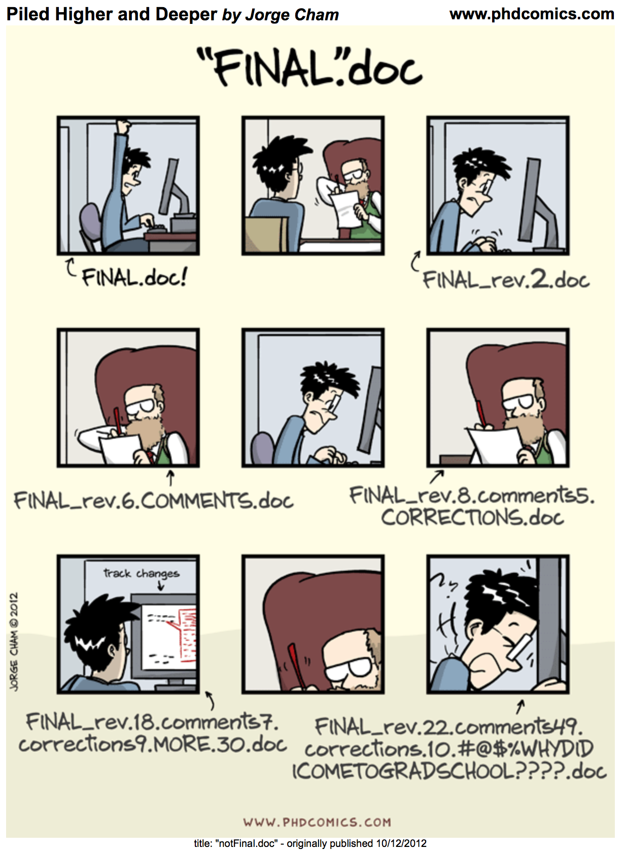
What is Git and GitHub?
Git is a version control system that tracks the history of changes to all files within a folder, known as a repository.
GitHub is a platform where you can store and share Git repositories.
Notes:
Before we dive into hands-on activities, let’s clarify two key concepts: Git and GitHub.
Git is a version control system that helps track changes in your files over time. Imagine working on a project where you need to keep track of edits, collaborate with others, and even go back to previous versions if needed. Git allows you to do that by managing all changes in a structured way.
GitHub, on the other hand, is a cloud-based platform that enables you to store, share, and collaborate on Git repositories. While Git works locally on your machine, GitHub makes it easy to back up your work online and collaborate with teammates in real time.
By using both Git and GitHub together, you can streamline your workflow, contribute to open-source projects, and manage code efficiently.

Slide 7
Common Term definitions
Issue | A task, bug, or request that needs to be addressed in a project.
Fork | A personal copy of someone else’s repository that allows you to make changes independently.
Branch | Branches create a safe environment to make changes and try things out. Main is “special / reserved” branch.
Commit | A recorded change to a file or set of files.
Push | The action of sending your committed changes to a remote repository.
Pull Request | A way to propose and review changes before merging them into the main project.
Merge(Conflict) | The process of integrating changes from one branch into another.
Markdown | A simple markup language for formatting text and 🤣🌈🦄, commonly used in documentation and README files.

Slide 8

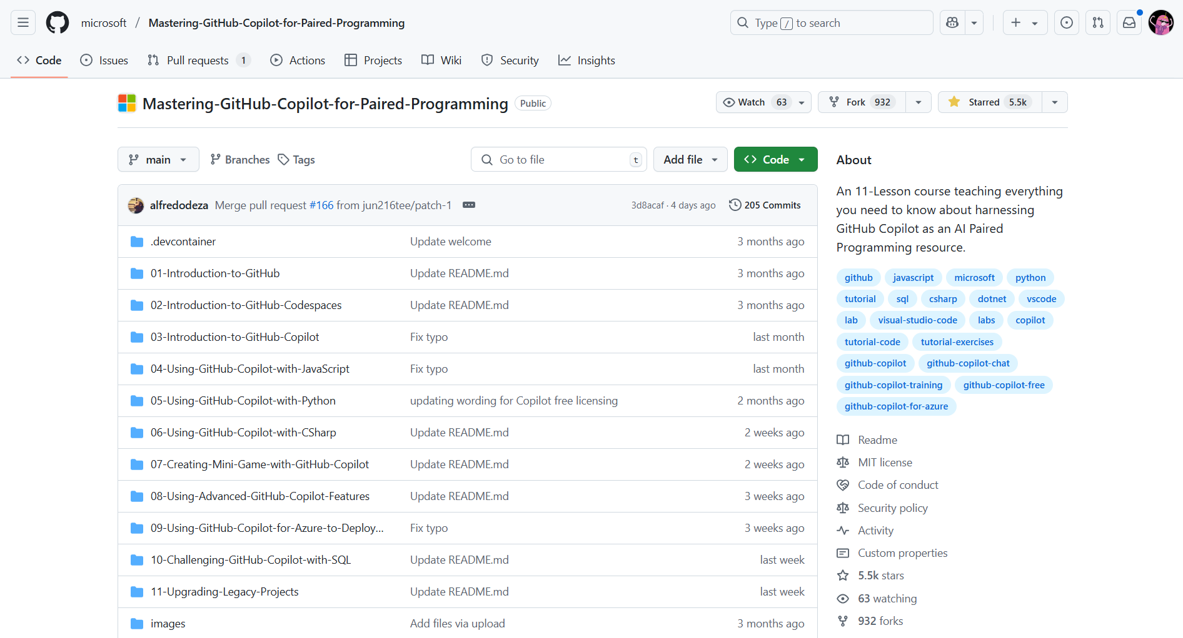
Let’s create a fork!
https://aka.ms/repo/githubcopilot
Notes:
Ask all participants to log in to their GitHub accounts and access the Mastering GitHub Copilot for Paired Programming repository to fork it

Slide 9

Introduction to GitHub
Go to the folder to view the instructions and click on the “Star Course” button.
In this exercise, you will:
Create a branch
Commit a file
Open a pull request
Merge your pull request

Slide 10



https://education.github.com/experiences/foundations_certificate
Foundations of Git
Certification Course
https://learn.gitkraken.com/

Slide 11


Code with GitHub Codespaces

Slide 12
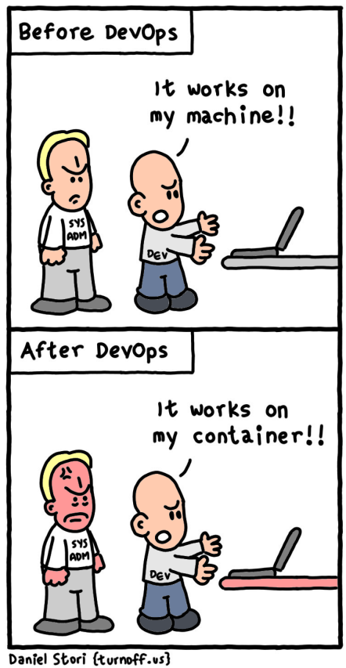
“We lost a whole day getting a QA engineer running on that project.”
“It works on my laptop. Why doesn’t it work on yours?”
“Can I have a 16-core machine?”
“I have no idea what I’ve installed over the years?”
Notes:
Setting up the dev environment is one of the most common challenges faced by development teams.

Slide 13
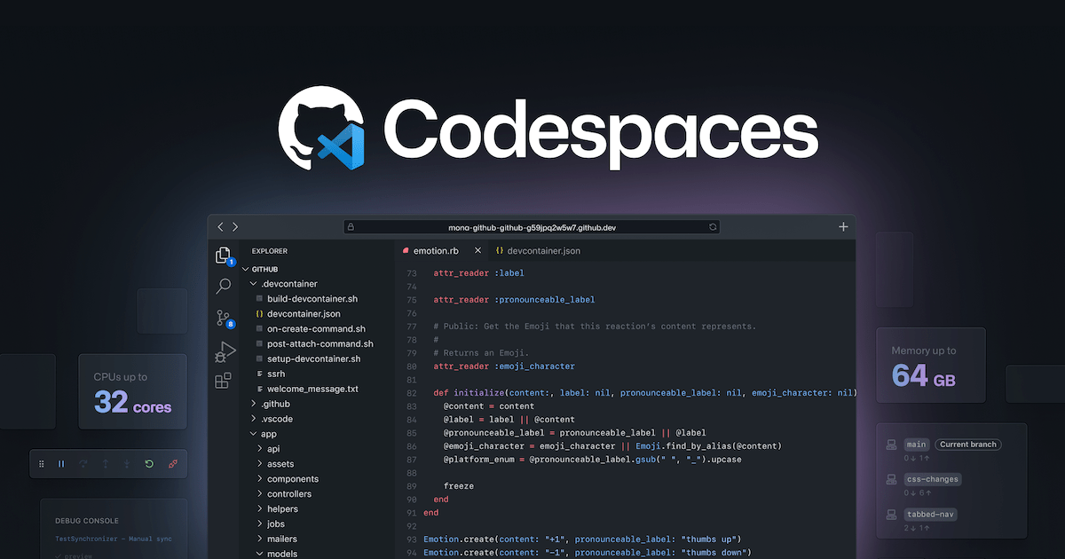
Notes:
GitHub Codespaces is a cloud-hosted dev environment. This means you can access your development setup from anywhere, without needing to configure it on your local machine.
Work collaboratively with other via Live Share.

Slide 14
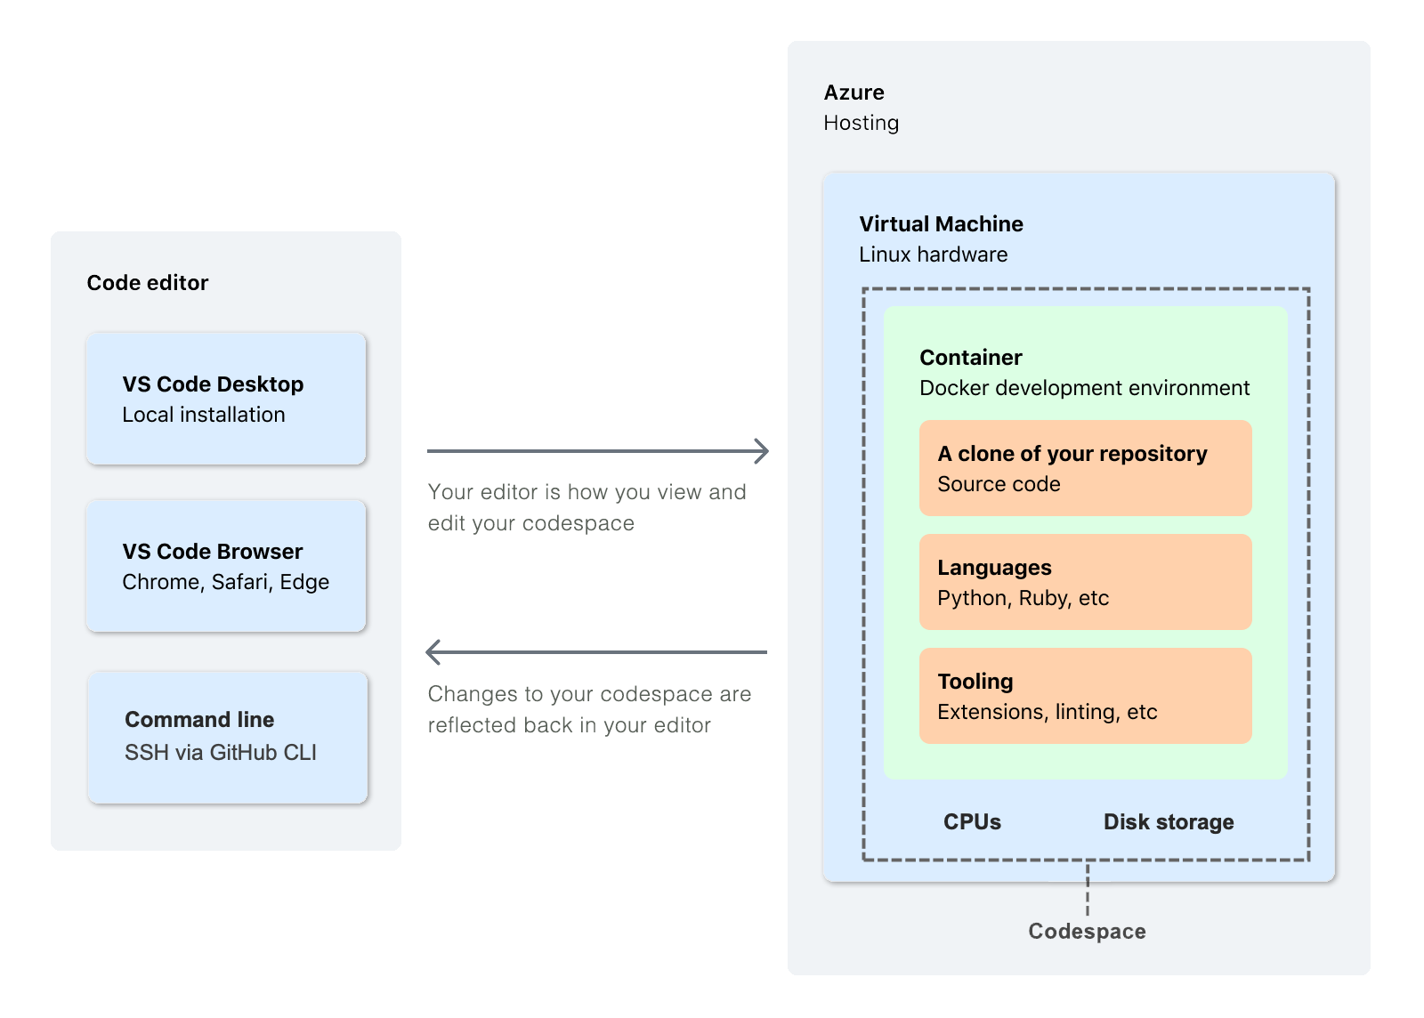
Notes:
When you work in a Codespace, the environment you're working in, is created using a development container, or dev container, hosted on a virtual machine.
Development containers, or dev containers, are Docker containers that are specifically configured to provide a complete development environment.
You can configure the dev container for a repository so that Codespaces created for that repository provide a custom development environment, complete with all the tools and runtimes you need to work on a specific project.

Slide 15
Managed environments for any project
Fully-managed, on-demand dev environments that dramatically reduce setup and maintenance
Feel at home even when away
Environment can be configured, and your settings, themes, and Git identity, are roamed so the experience looks and feels like local
Develop from anywhere
Environment can be configured, and your settings, themes, and Git identity, are roamed so the experience looks and feels like local
Supercharged collaborative development
Fully collaborative environment, complete with AI-assisted development support
Notes:
Why use GitHub Codespaces?
• Fast to create and disposable. Create what you need and then dispose of them when you are finished.
• Managed environments which reduce the overall maintenance for you.
• Predictable pricing and you only pay for what you use with built-in auto-suspend.
• Save compute resources. When you move your development workload to the cloud, it frees the limited resources on your personal machine.

Slide 16
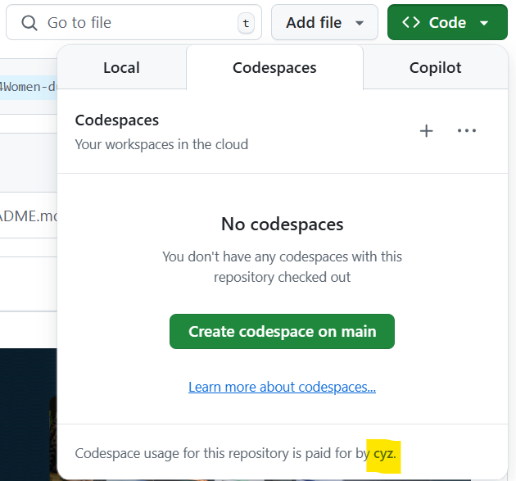
All personal GitHub accounts have a monthly quota of free use of GitHub Codespaces.
The free plan offers 120 hours of usage for
1 core or 60 hours for 2 cores, plus 15 GB of storage per month.
GitHub Pro offers 180 core hours of usage, plus 20 GB of storage per month.
Notes:
If you access a repository on GitHub and click the 'Code' button, you will see the option to open the project in a Codespace. The interface will indicate which user quota will be consumed for processing.
The free plan offers 120 hours of usage for 1 core or 60 hours for 2 cores, plus 15 GB of storage per month. This allows you to work on your projects at no additional cost, as long as you stay within these limits.
After working on your project, you can push your changes and pause your Codespace. This helps save the available hours of your free quota, ensuring that you maximize the efficient use of the provided resources.
About billing for GitHub Codespaces - GitHub Docs

Slide 17

Lab
Code with Codespaces
https://github.com/IntelliTect-Samples/Mastering-GitHub-Copilot-for-Paired-Programming

Slide 18
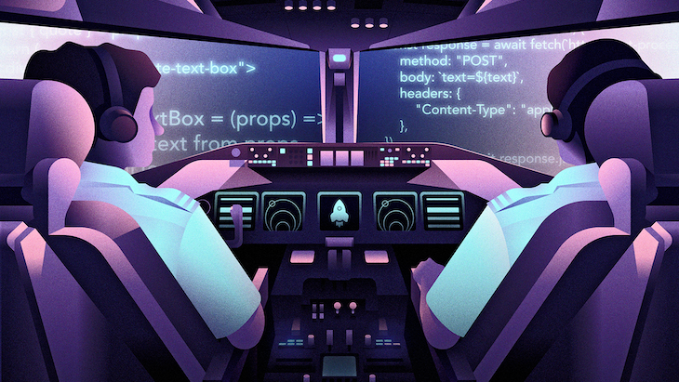

GitHub Copilot
Notes:
GitHub Copilot is an AI-powered code completion tool developed by GitHub in collaboration with OpenAI. It assists developers by providing code suggestions, autocompletions, and even entire code snippets based on the context of the code being written. It leverages machine learning models trained on a vast amount of publicly available code to offer context-aware suggestions, thereby enhancing productivity and helping developers write code more efficiently.
https://docs.github.com/copilot/about-github-copilot/github-copilot-features https://github.blog/ai-and-ml/github-copilot/github-copilot-spaces-bring-the-right-context-to-every-suggestion/

Slide 19
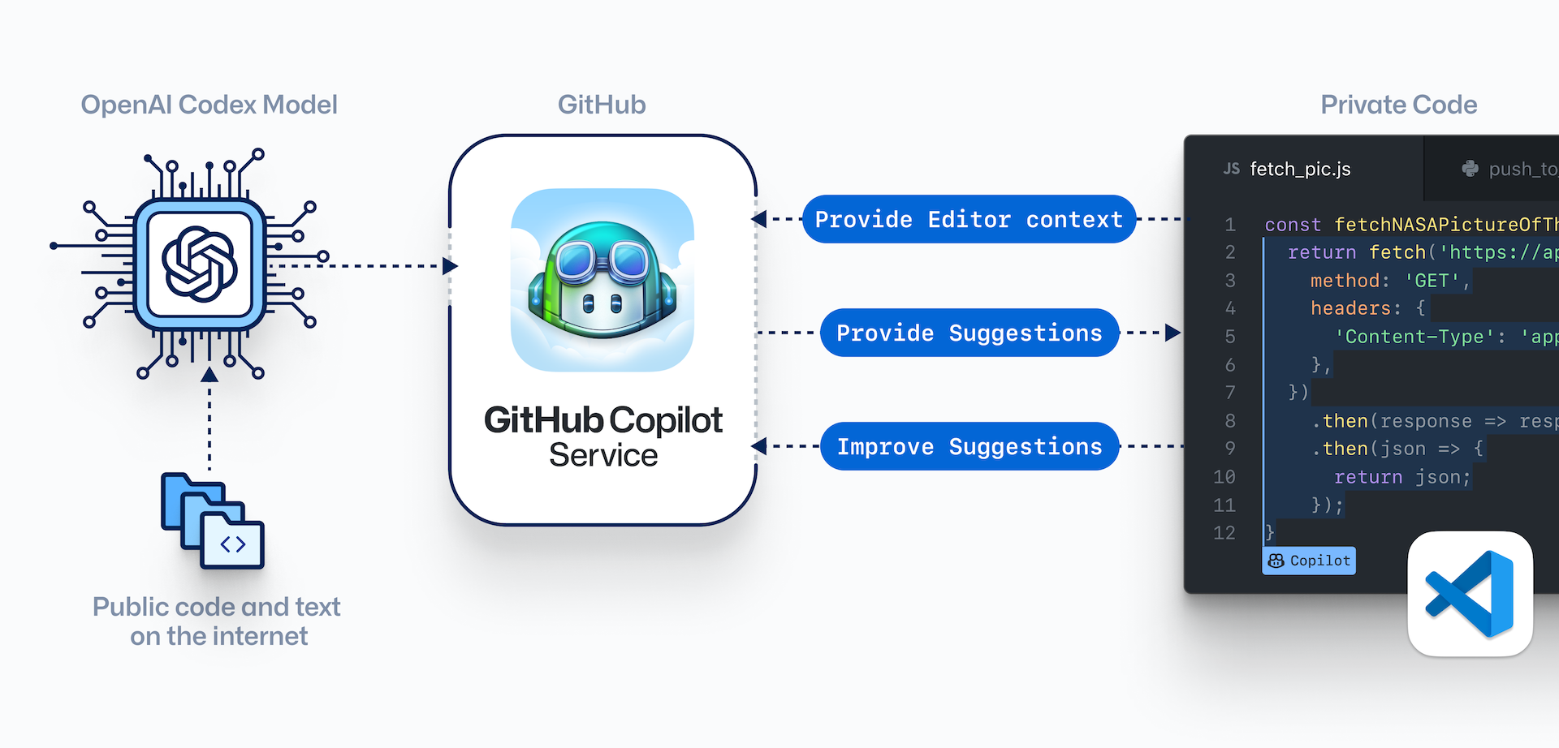
Notes:
GitHub Copilot is an innovative tool that leverages artificial intelligence to assist developers in writing code more efficiently. It works by integrating the OpenAI Codex Model, which is trained on publicly available code and text from the internet, with the GitHub Copilot Service.
When you start coding, GitHub Copilot provides context from the OpenAI Codex Model to understand what you are working on. It then offers suggestions for lines or blocks of code that you might need next. These suggestions are based on both public data and your private code, ensuring they are relevant and helpful. As you accept or reject these suggestions, GitHub Copilot learns and improves its future recommendations, making it a powerful companion for any developer.

Slide 20
Microsoft and GitHub's six principles of Responsible AI
Reliability and
Safety
Privacy and
Security
Fairness
Inclusiveness
Transparency
Accountability
Notes:
Microsoft is a global leader in Responsible AI, identifying six key principles that should guide AI development and usage. These principles are:
Fairness: AI systems should treat all people fairly.
Reliability and safety: AI systems should perform reliably and safely.
Privacy and security: AI systems should be secure and respect privacy.
Inclusiveness: AI systems should empower everyone and engage people.
Transparency: AI systems should be understandable.
Accountability: People should be accountable for AI systems.

Slide 21
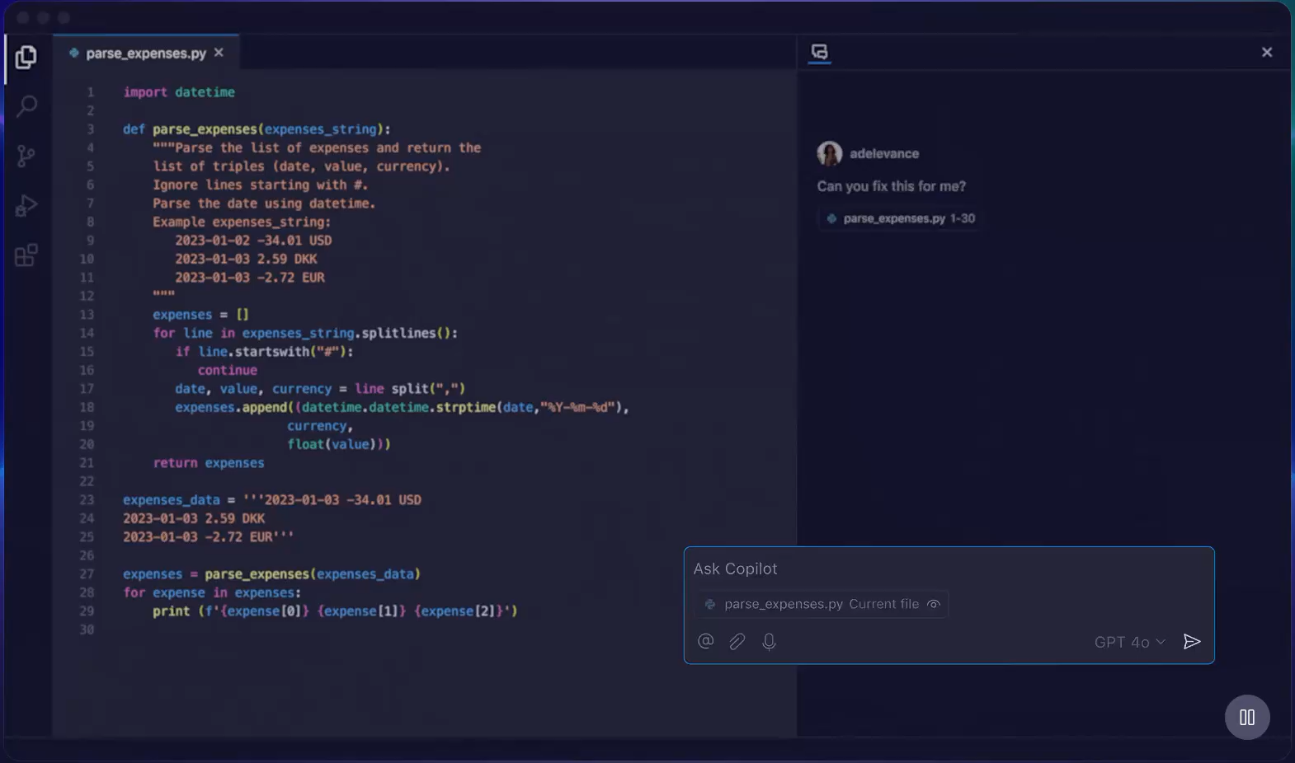
Prompt Engineering
Your prompt should be single and specific.
Context is EVERYTHING!
Iterate, iterate,
and iterate.
Notes:
Prompt engineering is the process of crafting clear instructions to guide AI systems, like GitHub Copilot, to generate context-appropriate code tailored to your project's specific needs. This ensures the code is syntactically, functionally, and contextually correct.
Principles of prompt engineering:
Single: Always focus your prompt on a single, well-defined task or question. This clarity is crucial for eliciting accurate and useful responses from Copilot.
Specific: Ensure that your instructions are explicit and detailed. Specificity leads to more applicable and precise code suggestions.
Short: While being specific, keep prompts concise and to the point. This balance ensures clarity without overloading Copilot or complicating the interaction.
Surround: Utilize descriptive filenames and keep related files open. This provides Copilot with rich context, leading to more tailored code suggestions.

Slide 22
How Copilot learns from your prompts? 🤔
Notes:
In summary, Zero-shot, One-shot, and Few-shot learning are powerful techniques that enable AI models to generalize from minimal data. These approaches are particularly valuable in scenarios where data is limited, allowing models to perform effectively even with few or no specific examples.

Slide 23
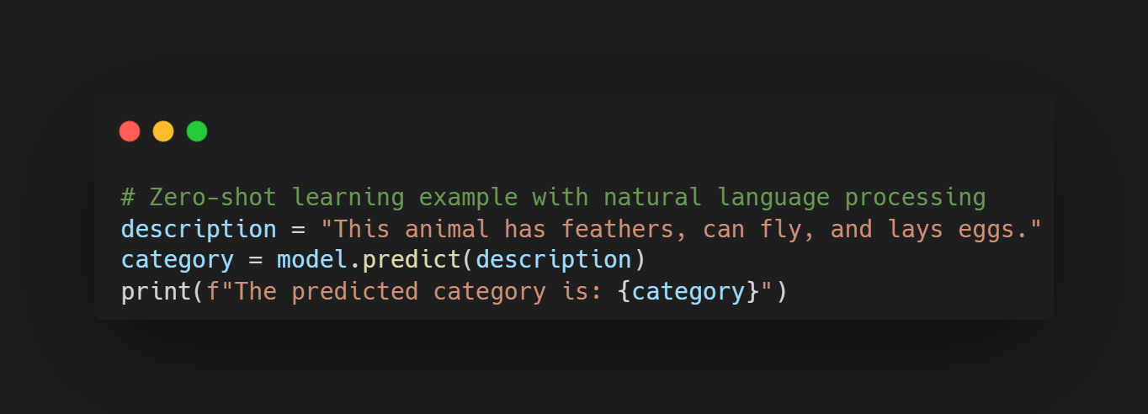
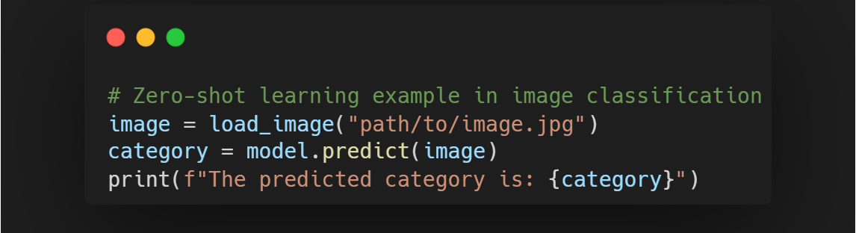
Zero-shot learning
Notes:
First, we have Zero-shot learning.
This is a method where the model is capable of making predictions for classes that were not seen during training. In other words, the model can generalize to new classes without having examples of those classes in the training set.
For example, imagine we have a natural language processing model. If we provide it with a description of an animal, it should be able to predict the category of the animal, such as mammal, reptile, or bird, even if it has never seen a specific example of that animal before.
[click to show the second snippet]
Another example could be in image recognition. Here, we provide an image of an animal to the model, and it should be able to predict the category of the image without having been trained on that specific category.

Slide 24
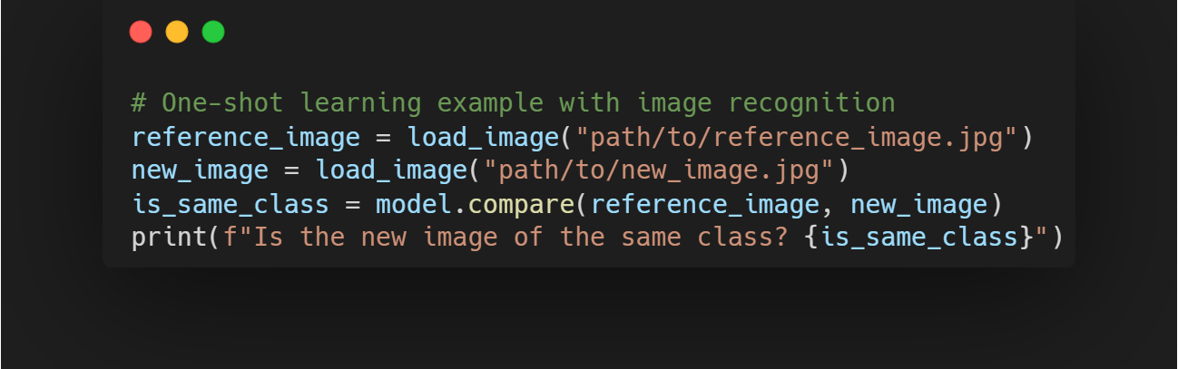
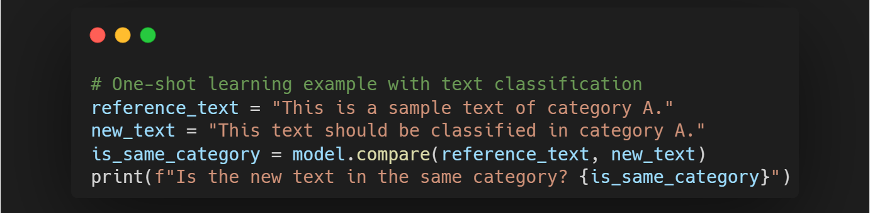
One-shot learning
Notes:
Now let's talk about One-shot learning.
This approach is used when we have only one example of each class to train the model. The model must be able to recognize new instances of the same class from that single example.
For example, in image recognition, we can give the model a single reference image of a new class. When a new image of the same class is presented, the model should be able to recognize that it belongs to the same class.
[click to show the second snippet]
Another example is in text classification, where we give the model a single example of a text category. When a new text is presented, the model should be able to classify it in the same category.

Slide 25
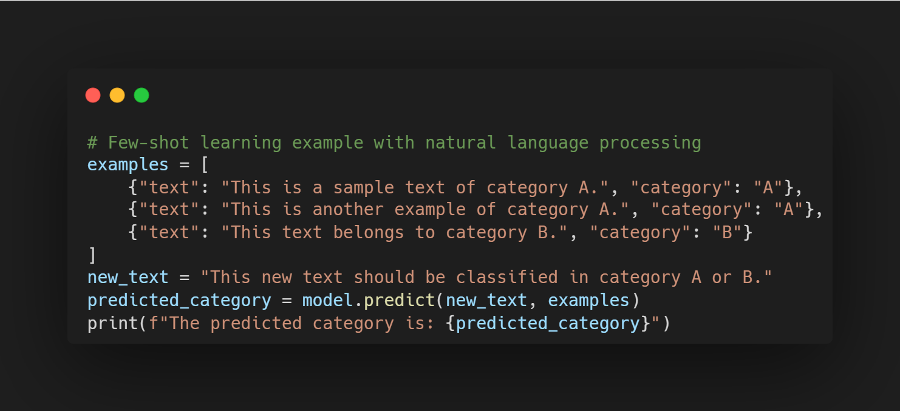
Few-shot learning
Notes:
Finally, we have Few-shot learning. This approach is used when we have a small number of examples of each class to train the model. The model must be able to generalize from these few examples to classify new instances.
For example, in text classification, we can give the model a few examples of different categories. When a new text is presented, the model should be able to classify it into one of these categories.

Slide 26
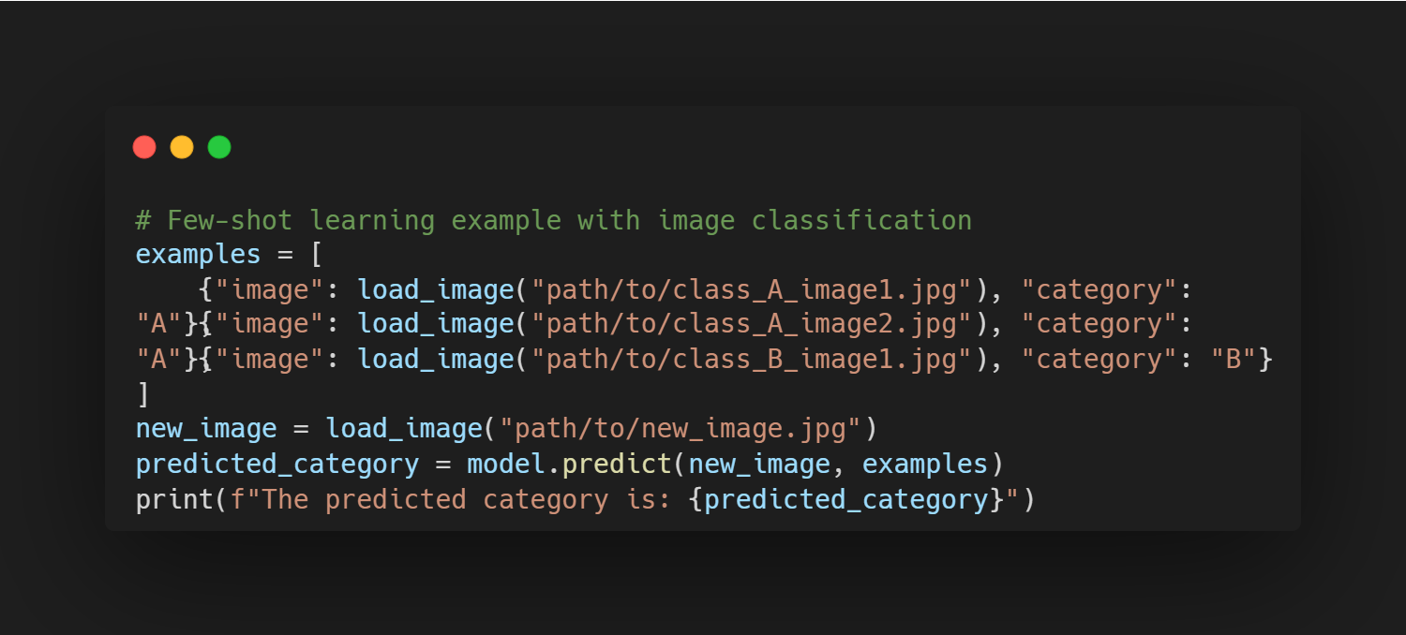
Few-shot learning
Notes:
Another example is in image classification, where we give the model a few images of each class. When a new image is presented, the model should be able to classify it correctly.
To summarize, we have seen three different machine learning approaches: Zero-shot learning, which deals with unseen classes, One-shot learning, which uses a single example per class, and Few-shot learning, which uses a few examples per class. Each of these approaches has its own applications and advantages depending on the context and the amount of data available.

Slide 27
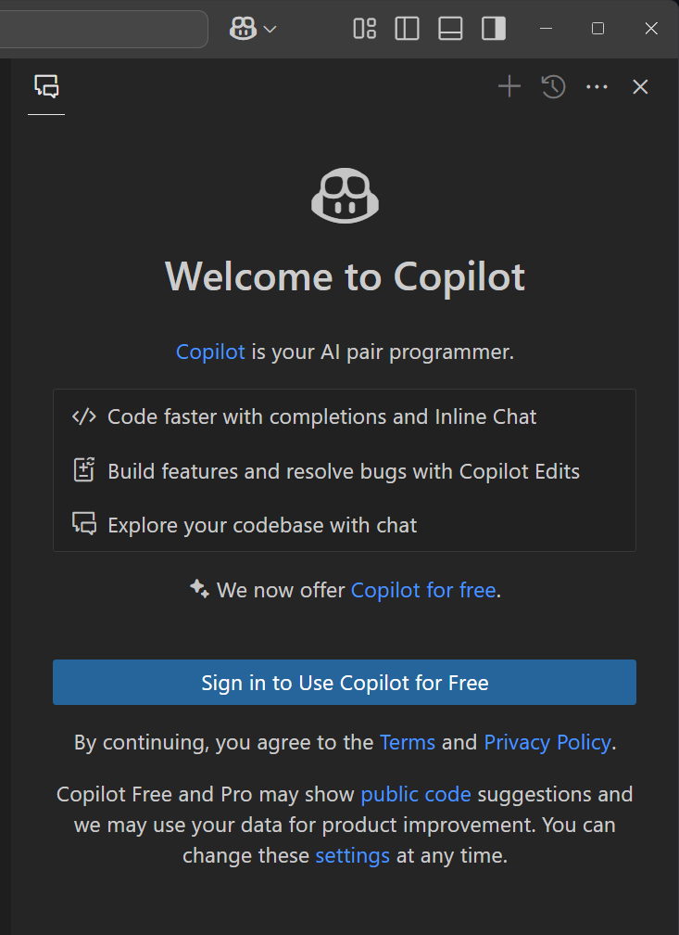
GitHub Copilot time! 😻
If you have not activated your account yet:
Open the Codespaces in the lab and click on the GitHub Copilot icon.
In the GitHub Chat panel, click the option to use GitHub Copilot for free to activate.
Notes:
Now, guide the participants to the workshop repository they will be using.
Remind them to activate the GitHub Copilot free tier if they do not have an active license. The free version is sufficient for learning purposes and will allow them to use Copilot features throughout the workshop.

Slide 28
Lab
Getting Started with
GitHub Copilot
https://github.com/IntelliTect-Samples/Mastering-GitHub-Copilot-for-Paired-Programming

Slide 29
The best model depends on your use case:
For balance between cost and performance:
Try GPT-4.1 or Claude Sonnet 3.7.
For fast, low-cost support for basic tasks:
Try o4-mini or Claude Sonnet 3.5.
For deep reasoning or complex coding challenges:
Try o3, GPT-4.5, or Claude Sonnet 3.7.
For multimodal inputs and real-time performance:
Try Gemini 2.0 Flash or GPT-4.1.
Consider cost of premium models.
How to pick the right model? 🤔
https://docs.github.com/copilot/using-github-copilot/ai-models/choosing-the-right-ai-model-for-your-task
Notes:
In summary, Zero-shot, One-shot, and Few-shot learning are powerful techniques that enable AI models to generalize from minimal data. These approaches are particularly valuable in scenarios where data is limited, allowing models to perform effectively even with few or no specific examples.

Slide 30
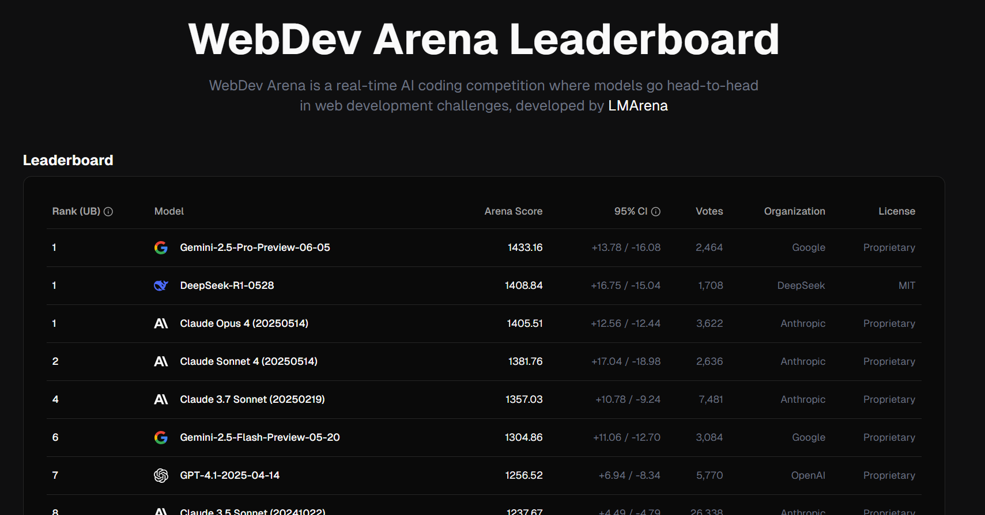
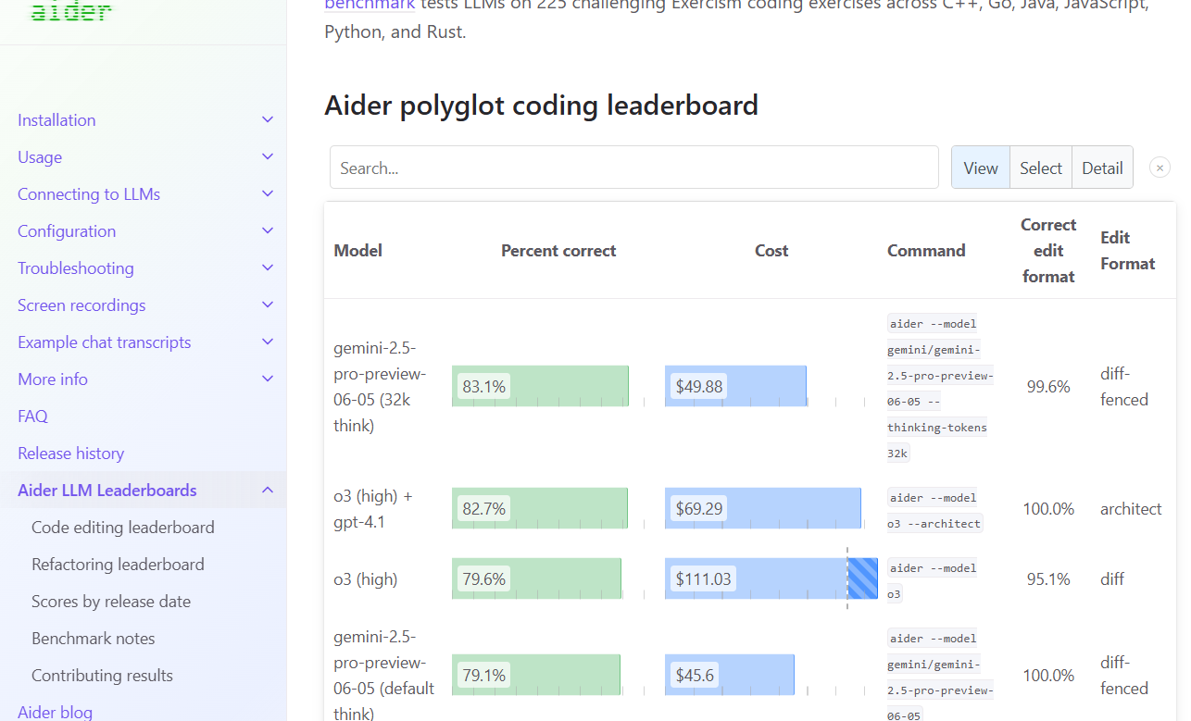
Consider third party benchmarks:
LMArena:: https://web.lmarena.ai/leaderboard
Aider: https://aider.chat/docs/leaderboards/
How to pick the right model? 🤔
https://docs.github.com/copilot/using-github-copilot/ai-models/choosing-the-right-ai-model-for-your-task
Notes:
In summary, Zero-shot, One-shot, and Few-shot learning are powerful techniques that enable AI models to generalize from minimal data. These approaches are particularly valuable in scenarios where data is limited, allowing models to perform effectively even with few or no specific examples.

Slide 31
Be clear and specific in your prompts for better results.
Give Copilot context by referencing files, code, or errors.
Use step-by-step instructions for complex tasks.
How craft the perfect prompt 🎨
https://docs.github.com/copilot/using-github-copilot/copilot-chat/prompt-engineering-for-copilot-chat
Notes:
In summary, Zero-shot, One-shot, and Few-shot learning are powerful techniques that enable AI models to generalize from minimal data. These approaches are particularly valuable in scenarios where data is limited, allowing models to perform effectively even with few or no specific examples.

Slide 32
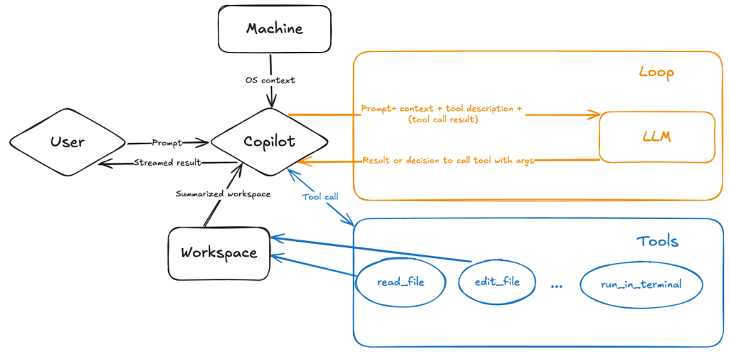
Notes:
GitHub Copilot is an innovative tool that leverages artificial intelligence to assist developers in writing code more efficiently. It works by integrating the OpenAI Codex Model, which is trained on publicly available code and text from the internet, with the GitHub Copilot Service.
When you start coding, GitHub Copilot provides context from the OpenAI Codex Model to understand what you are working on. It then offers suggestions for lines or blocks of code that you might need next. These suggestions are based on both public data and your private code, ensuring they are relevant and helpful. As you accept or reject these suggestions, GitHub Copilot learns and improves its future recommendations, making it a powerful companion for any developer.

Slide 33
Lab
Creating a mini-game
https://github.com/IntelliTect-Samples/Mastering-GitHub-Copilot-for-Paired-Programming

Slide 34
Lab
Using GitHub Copilot
with CSharp
https://github.com/IntelliTect-Samples/Mastering-GitHub-Copilot-for-Paired-Programming

Slide 35


https://github.com/github/github-mcp-server

Slide 36
Lab
Integrate MCP
With Copilot
https://github.com/IntelliTect-Samples/Mastering-GitHub-Copilot-for-Paired-Programming

Slide 37
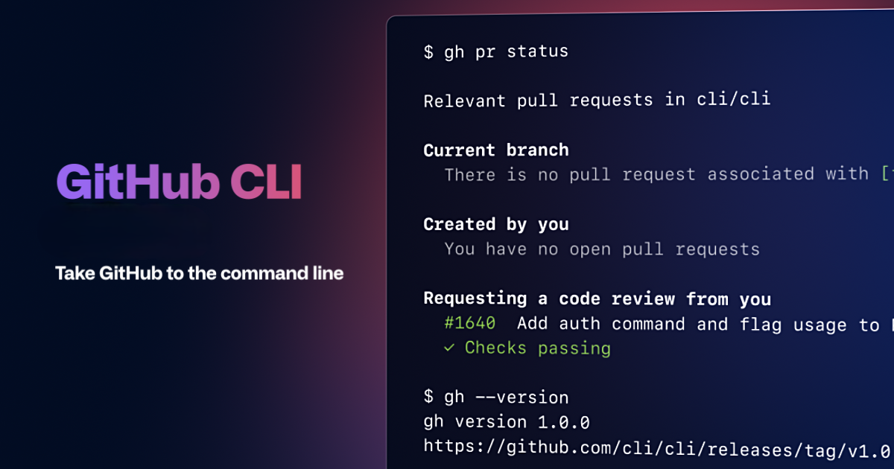

https://cli.github.com/
Notes:
gh codespace --help gh codespace[cs] code
gh codespace[cs] ssh

Slide 38
https://cli.github.com/
Notes:
gh codespace --help gh codespace[cs] code
gh codespace[cs] ssh VSCode will prompt to add the extension and authenticate the first time you run it.

Slide 39
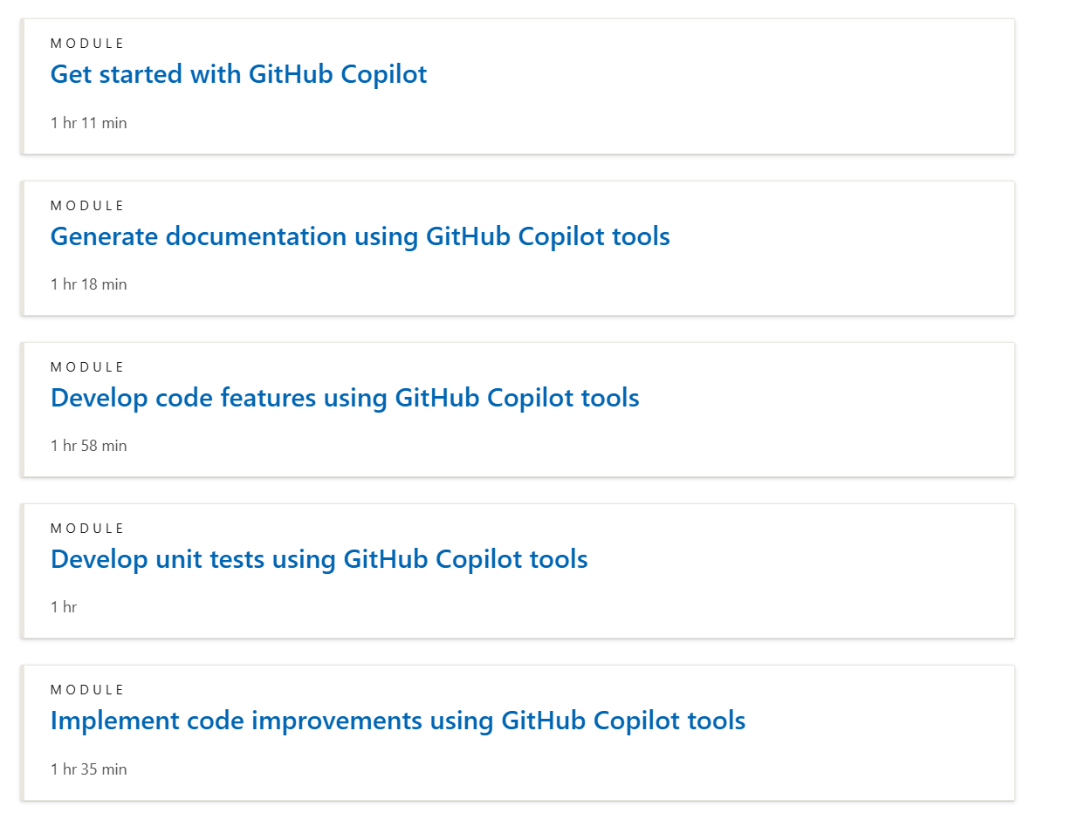

Keep learning!
aka.ms/learn/githubcopilot
Notes:
Please, refer to a learning path as an additional resource for learning.

Slide 40
Keep learning!
aka.ms/learn/githubcopilot
Notes:
Please, refer to a learning path as an additional resource for learning.

